Slide 1
Jmeter 5.3. Advanced usage

Slide 2
Initial instruments to start with
https://jmeter.apache.org/download_jmeter.cgi => download jmeter of latest version
http://chrome.google.com/webstore/detail/blazemeter-the-load-testi/mbopgmdnpcbohhpnfglgohlbhfongabi => Install blazemeter chrome plugin
More about blazemeter chrome extension: https://guide.blazemeter.com/hc/en-us/articles/206732579-The-BlazeMeter-Chrome-Extension-Record-JMeter-Selenium-or-Synchronized-JMeter-and-Selenium-The-BlazeMeter-Chrome-Extension:-Record-JMeter,-Selenium,-or-Synchronized-JMeter-and-Selenium
https://jmeter-plugins.org/install/Install/ => install plugins manager in jmeter

Slide 3
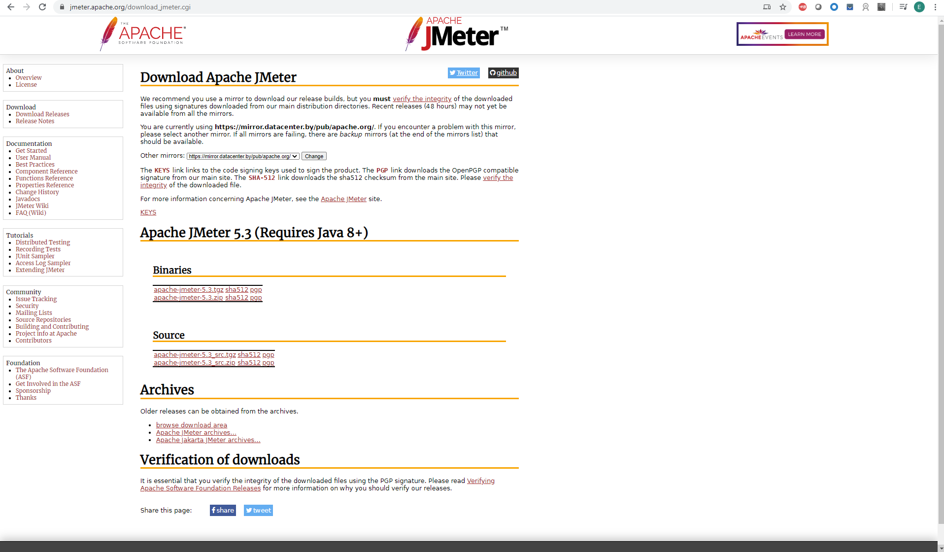
Jmeter distributive .zip
Download .zip archive and extract

Slide 4
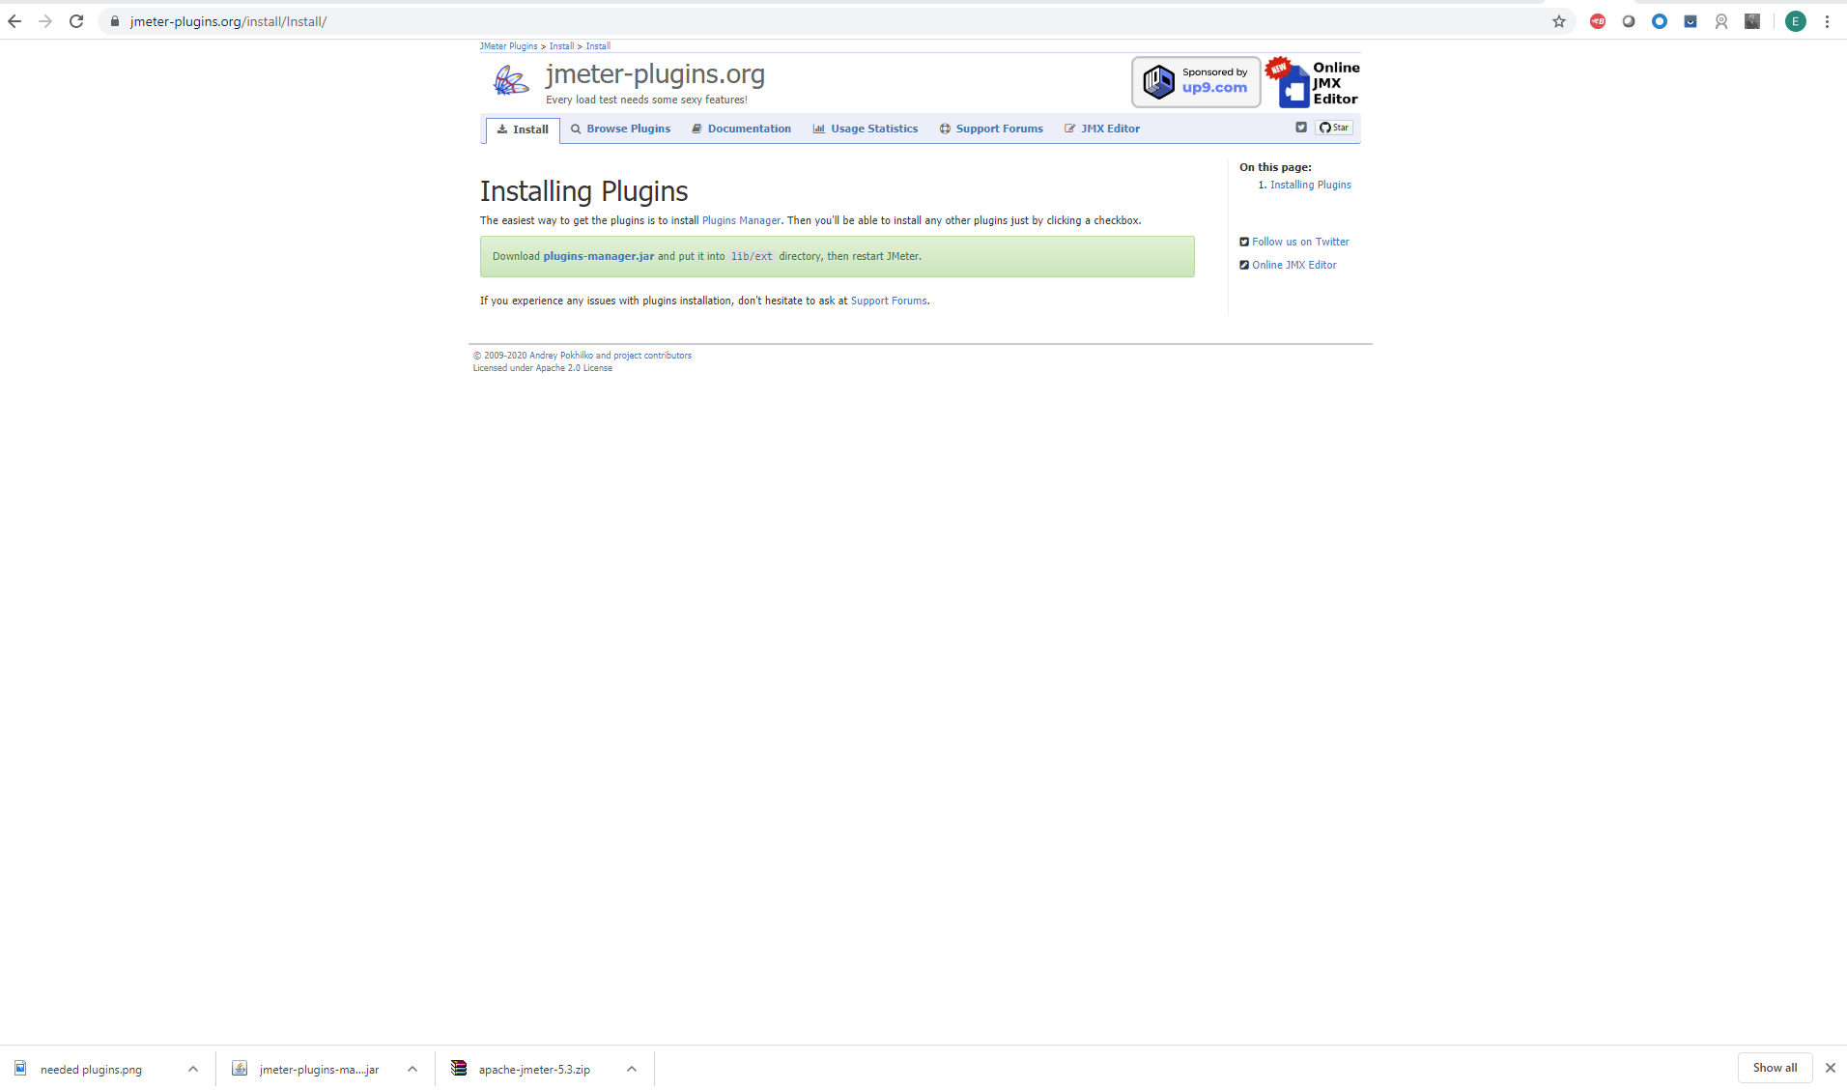
Jmeter addon/plugin manager

Slide 5
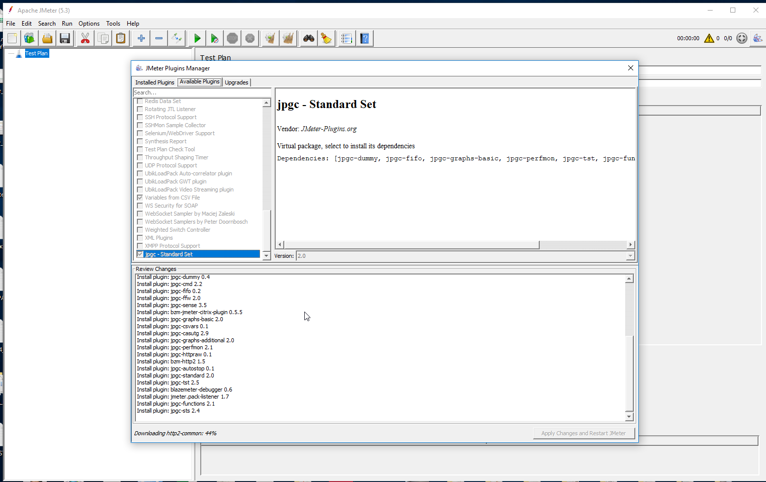
Installation of required plugins

Slide 6
Jmeter generic best practices
JMeter has some limitations especially when it is run in a distributed environment. Following these guidelines will assist in creating a real and continuous load −
Use multiple instances of JMeter in case, the number of threads are more.
Check the Scoping Rules and design accordingly.
Use naming conventions always for all elements.
Check the default browser Connectivity settings, before executing scripts.
Add Listeners appropriately.
Here are some suggestion to reduce resource requirements
Use non-GUI mode: jmeter -n -t test.jmx -l test.jtl.
Use as few Listeners as possible; if using the -l flag as above, they can all be deleted or disabled.
Disable the “View Result Tree” listener as it consumes a lot of memory and can result in the console freezing or JMeter running out of memory. It is, however, safe to use the “View Result Tree” listener with only “Errors” checked.
Rather than using lots of similar samplers, use the same sampler in a loop, and use variables (CSV Data Set) to vary the sample. Or perhaps use the Access Log Sampler.
Do not use functional mode.
Use CSV output rather than XML.
Only save the data that you need.
Use as few Assertions as possible.
Disable all JMeter graphs as they consume a lot of memory. You can view all of the real time graphs using the JTLs tab in your web interface.
Do not forget to erase the local path from CSV Data Set Config if used.
Clean the Files tab prior to every test run.

Slide 7
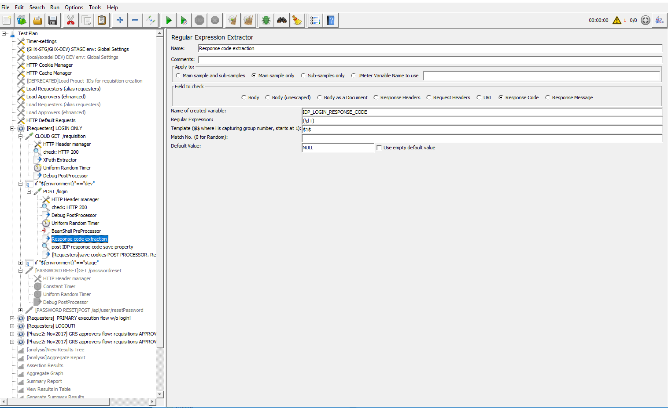
Jmeter regular expression extractors. Example.
https://www.tutorialspoint.com/jmeter/jmeter_regular_expressions.htm

Slide 8
Jmeter regular expression extractors. Fields (explanations)
name = "file" value = "(.+?)">
The special characters above are −
( and ) − these enclose the portion of the match string to be returned
. − match any character
+ − one or more times
? − stop when first match succeeds
The following info provides a description of the fields used in the above screenshot −
Sr.No Field & Description
1 Reference Name
The name of the variable in which the extracted test will be stored (refname).
2 Regular Expression
The pattern against which the text to be extracted will be matched. The text groups that will extracted are enclosed by the characters '(' and ')'. We use '.+?' to indicate a single instance of the text enclosed by the <td..>..</td> tags. In our example the expression is − <td id = "ID">(+?)</td>\s*<td id = "Name">(+?)</td>\s*
3 Template
Each group of extracted text placed as a member of the variable Person, following the order of each group of pattern enclosed by '(' and ')'. Each group is stored as refname_g#, where refname is the string you entered as the reference name, and # is the group number. $1$ to refers to group 1, $2$ to refers to group 2, etc. $0$ refers to whatever the entire expression matches. In this example, the ID we extract is maintained in Person_g1, while the Name value is stored in Person_g2.
4 Match No.
Since we plan to extract only the second occurrence of this pattern, matching the second volunteer, we use value 2. Value 0 would make a random matching, while a negative value needs to be used with the ForEach Controller.
5 Default
If the item is not found, this will be the default value. This is an optional field. You may leave it blank.

Slide 9
Jmeter Xpath extractors
https://octoperf.com/blog/2018/04/10/jmeter-xpath-extractor/
XPath expressions are a language to select nodes within an XML document. XPath supports different kind of expressions to select various parts of the document.
Expression Selects
name All nodes with name name
/ starting from the root node
// Selects nodes in the document from the current node that match the selection no matter where they are
. current node
.. parent of the current node
@ node with a given attribute

Slide 10
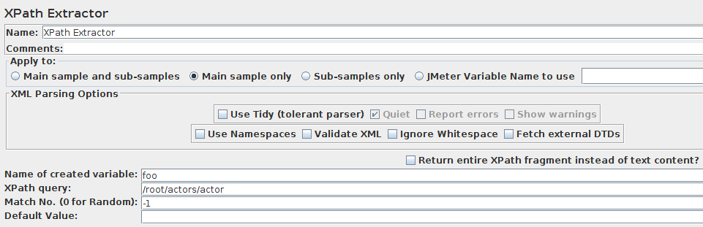
Jmeter Xpath extractor sampler.

Slide 11
Jmeter Xpath extractor parameters
JMeter XPath Extractor UI
JMeter’s XPath Extractor has some interesting advanced features:
Use Tidy (tolerant parser): If checked use Tidy to parse HTML response into XHTML,
Use Tidy” should be checked on for HTML response. Such response is converted to valid XHTML (XML compatible HTML) using Tidy,
Use Tidy” should be unchecked for both XHTML or XML response (for example RSS).
For HTML, CSS/JQuery Extractor is the correct and performing solution. Don’t use XPath for HTML extractions.
Tidy should be used when receiving invalid XML responses. Tidy is much more tolerant than the built-in XML parser.
When Tidy is selected:
Quiet: Sets the Tidy Quiet flag ,
Report Errors If a Tidy error occurs, then set the Assertion accordingly,
Show warnings: Sets the Tidy showWarnings option.
When Tidy is not selected:
Use Namespaces: If checked, then the XML parser will use namespace resolution.(see note below on NAMESPACES) Note that currently only namespaces declared on the root element will be recognised. See below for user-definition of additional workspace names,
Validate XML: Check the document against its schema,
Ignore Whitespace: Ignore Element Whitespace,
Fetch External DTDs: If selected, external DTDs are fetched,
Return entire XPath fragment instead of text content? If selected, the fragment will be returned rather than the text content. For example //title would return <title>Apache JMeter</title> rather than Apache JMeter. In this case, //title/text() would return Apache JMeter.

Slide 12
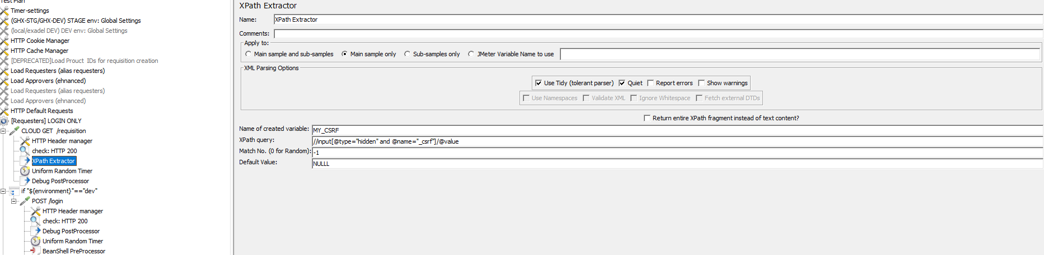
Jmeter Xpath extractor. Practical example #1

Slide 13
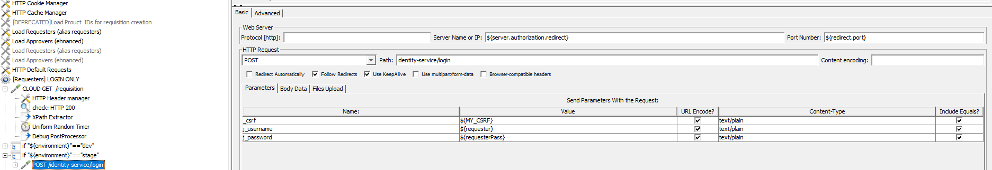
Jmeter Xpath extractor. Practical example #2

Slide 14
Jmeter Xpath extractor. Practical example #3. SAML (Security Assertion Markup Language) Authentication pt1.
SAML (Security Assertion Markup Language) Authentication
SAML, Security Assertion Markup Language, defines interoperability and protocol between the identity provider and the service provider, for exchanging authentication and authorization data, by the means of tokens.
Step 1 - The user attempts to access the Service Provider’s protected resource
As the user has not been authenticated, the SP redirects the user to the identity provider URL, to create a token. This identity provider URL is added by the SP from the SAML configuration. While redirecting, the application adds the SAMLRequest parameter to the query string. The IdP returns the HTML page, which has all required parameters to continue authentication. This is the step the user is usually presented with the login screen to enter user credentials (if user is authenticated via login / password) on the browser.

Slide 15
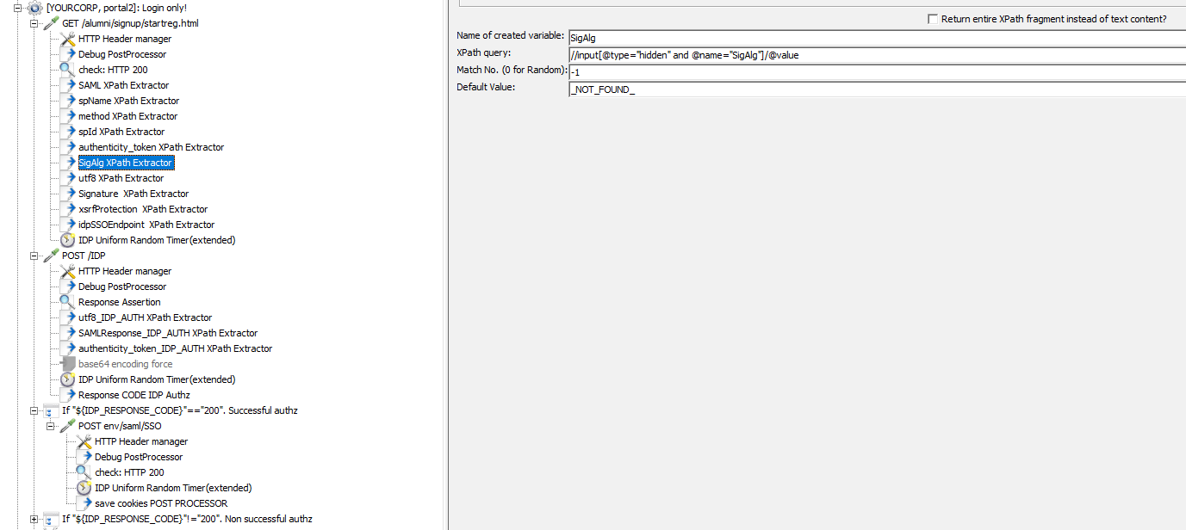
Jmeter Xpath extractor. Practical example #3. SAML (Security Assertion Markup Language) Authentication pt2.

Slide 16
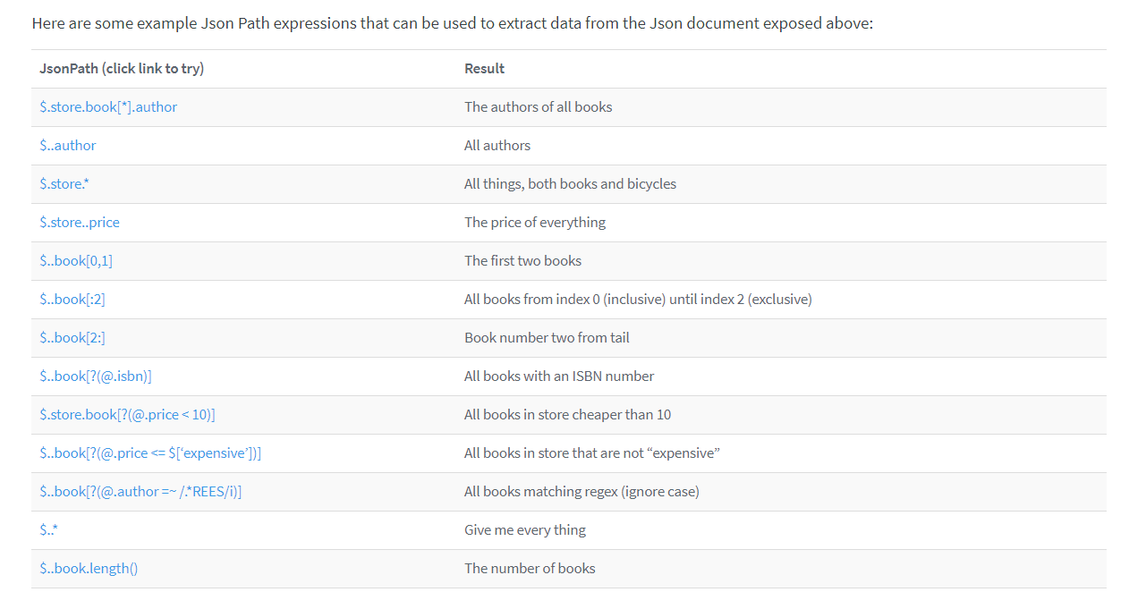
Json extractor. Json conditional extractor
https://octoperf.com/blog/2017/03/09/how-to-extract-data-from-json-response-using-jmeter/

Slide 17
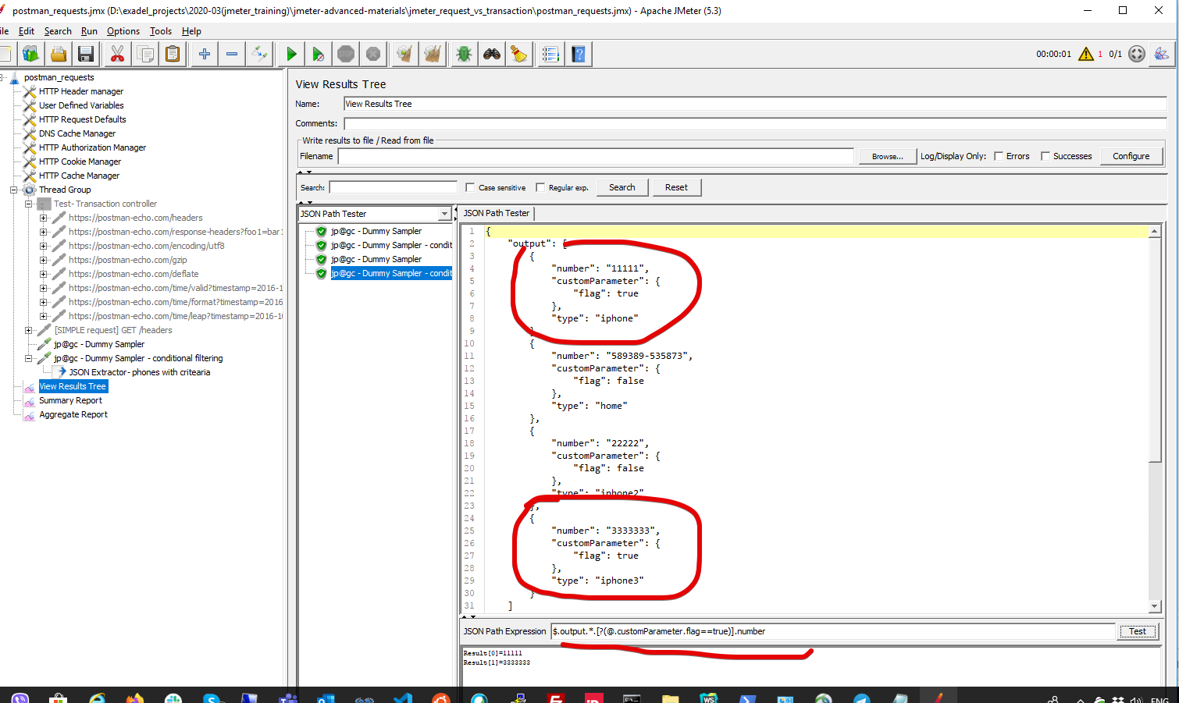
Json extractor. Conditional formatting. Example

Slide 18
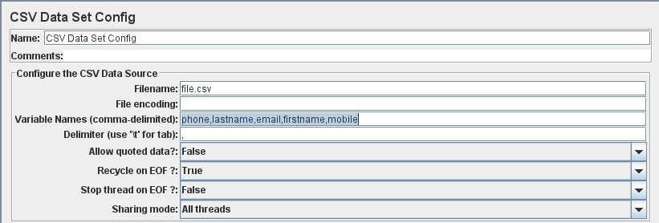
Jmeter CSV loader
If your CSV file looks like:
9998885551,john25,azp25@gmail.com,ricky25,9820420420
9998885552,john26,azp26@gmail.com,ricky26,9820420421
....
Configuration should be the following:
Filename: full path to your source .csv file
Variable Names: phone,lastname,email,firstname,mobile
Delimiter: ,
Populate other values according to your test scenario i.e. whether you want test to stop on .csv file end or re-spin or whatever.

Slide 19
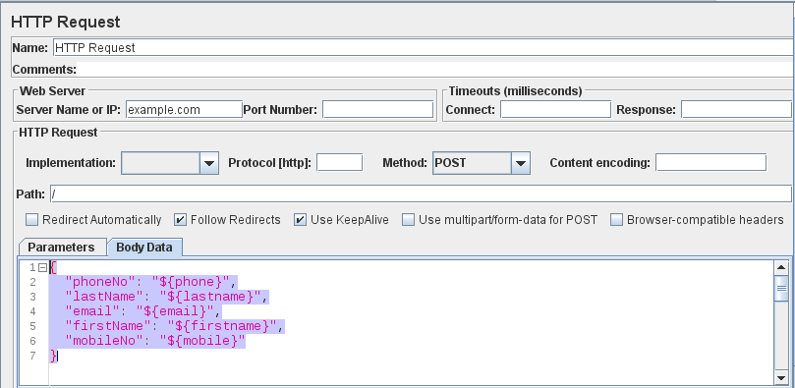
Jmeter CSV loader. Request
The main point is that variables defined in the CSV Data Set Config need to match the ones in the HTTP Request.
See Using CSV DATA SET CONFIG guide for detailed instructions.
I would also recommend adding the following entry to your HTTP Header Manager:
Name: Content-Type
Value: application/json
elsewise your request will be treated like plain text and may fail.

Slide 20
Jmeter CSV loader example
External loader .jmx example

Slide 21
Jmeter. Populating .csv file with data via beanshell
.jmx example

Slide 22
Jmeter execution flow. Timers.Timers scope #1
https://www.blazemeter.com/blog/comprehensive-guide-using-jmeter-timers
https://www.flood.io/blog/jmeter-tutorial-how-to-use-jmeter-timers
A high-level overview of how JMeter works looks as follows:
- When a Test Plan is started, JMeter kicks off a thread per virtual user
- Each thread starts executing samplers upside down (or according to the Logic Controllers, if any) as fast as it can
- When no samplers are left to execute and no loops to iterate the thread is being shut down
Think times may vary. For example, if the user is watching images, he/she takes seconds between performing actions (requesting next image). Or, for another example, If the user replies to a forum post, it may take minutes to compose the response and the amount of requests while the user’s typing will be minimal (i.e. periodical auto-save draft) or even zero.
Assuming all of the above, 2 conclusions can be made:
Timers need to be used.
There is no “recipe” or recommended think time values, as think times may vary from application to application.
Just like JMeter Assertions, JMeter Timers also have their scope, but unlike Assertions Timers, they are executed before each sampler in their scope. If there is more than one timer in the scope, all the timers will be processed before the sampler occurs. Additionally, timer execution time is not being recorded, so if the Timer pauses the thread for 1 second and the sampler execution time is 3 seconds, 3 seconds will be recorded as the sampler execution time. If you need to record the Timer execution time as well, you need to use Transaction Controller.

Slide 23
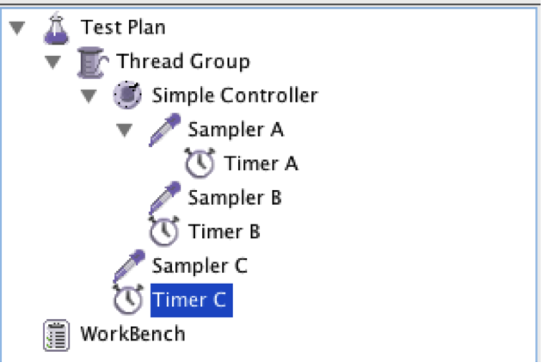
Jmeter execution flow. Timers.Timers scope #2
- Timer A - applicable to Sampler A only
- Timer B - applicable to Sampler A and Sampler B
- Timer C - applicable to Sampler A, Sampler B and Sampler C
- The Timers are executed before the sampler’s execution
- The Timer execution time is not added to the sampler execution time

Slide 24
Jmeter Timers types.
There are the following Timer test elements available:
- Constant Timer
- Uniform Random Timer
- Gaussian Random Timer
- Poisson Random Timer
- Constant Throughput Timer
- Synchronizing Timer
- BeanShell Timer
- BSF Timer
- JSR223 Timer
Constant Timer and Uniform Random Timer - sufficient to cover 99% of test situations and encourage you to use them in your scripts. However if your think time simulation requirements are based on more complex mathematical and statistical distributions, you’re very welcome to get familiarized with the others.
The Constant Timer can be used to pause each thread for the same “think time” between requests.

Slide 25
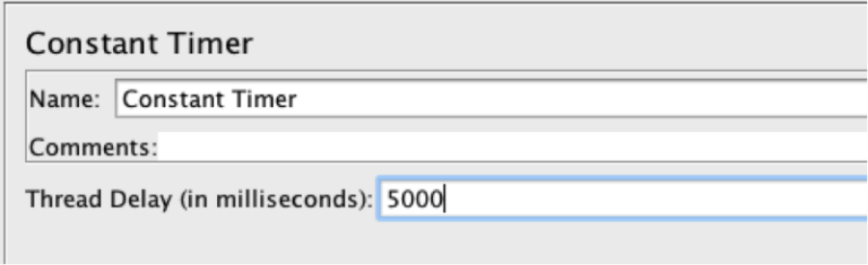
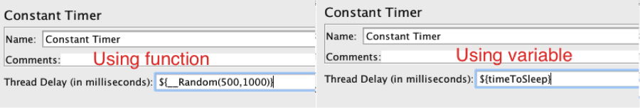
Jmeter Timers types: constant timer

Slide 26
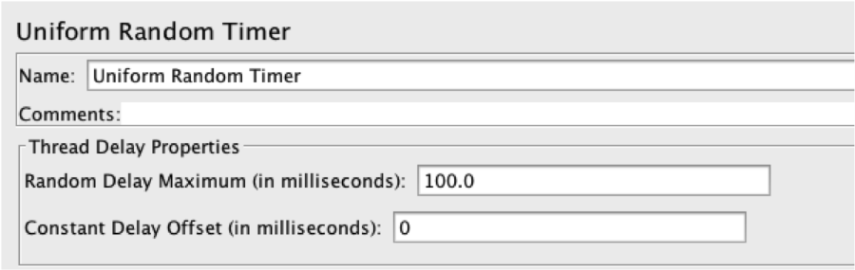
Jmeter timers types: Uniform Random Timer
The Uniform Random Timer pauses the thread by a factor of:
- The next pseudorandom uniformly-distributed value in range between 0.0 (inclusive) and 1.0 (exclusive)
- Multiplied by “Random Delay Maximum”
- Plus “Constant Delay Offset”
So the default configuration is:
- 100 Random Delay Maximum
- and 0 Constant Delay Offset

Slide 27
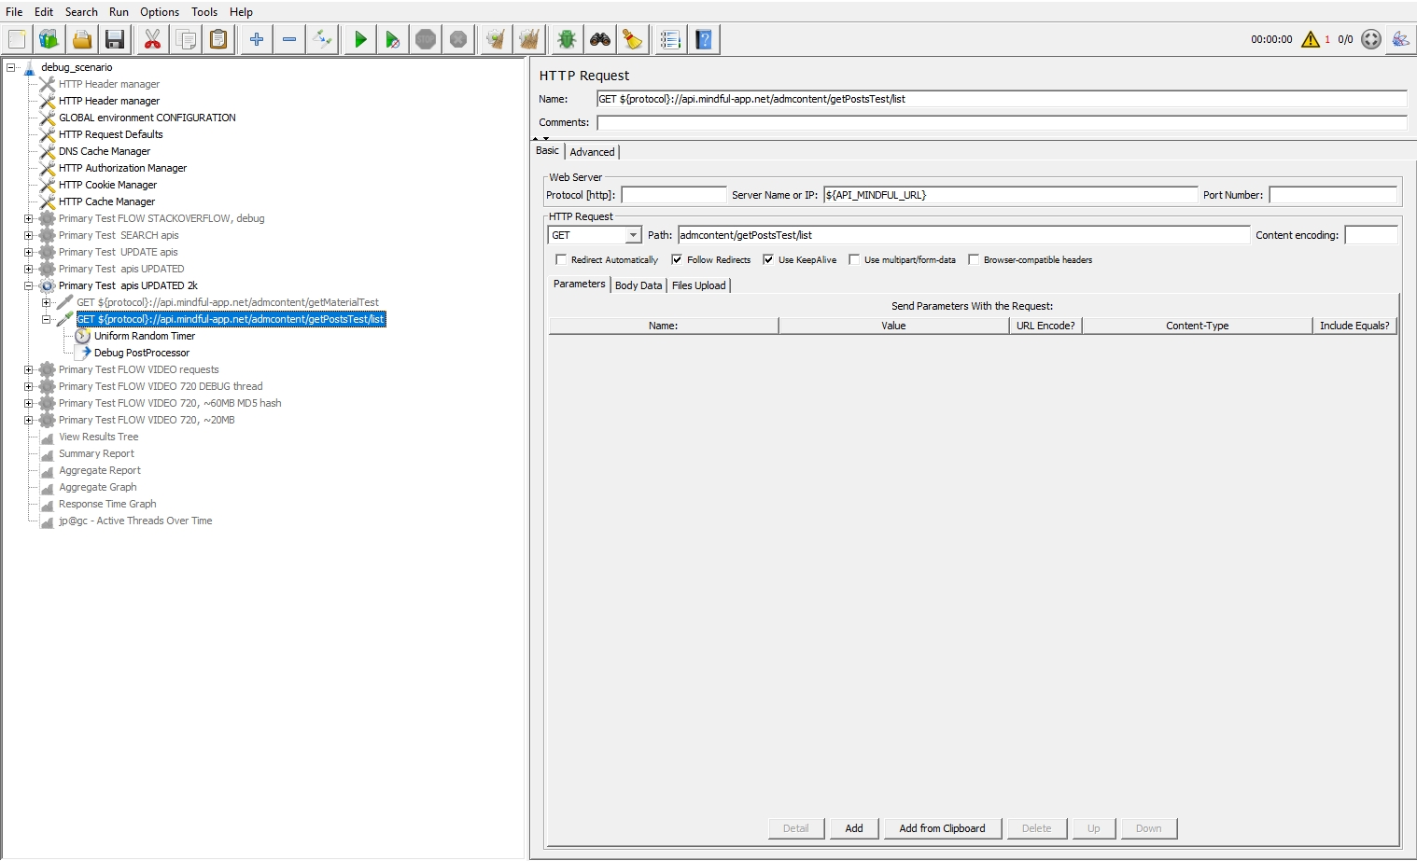
Jmeter test plan structure

Slide 28
Jmeter simple http request VS transaction controller
Transaction Controller: measures the overall time taken to finish a test execution
Simple http request: implies execution of a single HTTP request and measurement of this executed request

Slide 29
Jmeter. Different ways to debug scenario
https://octoperf.com/blog/2018/05/04/debug-jmeter-script/
Key debug components:
View Results Tree (Add > Listener > View Results Tree)
Debug Sampler Add > Sampler > Debug Sampler
JMeter Logs Viewer
Dummy Sampler (The Dummy Sampler is a powerful sampler: it can generate fake results with the content user wants.)

Slide 30
Jmeter Cookie Manager. Overview
https://www.blazemeter.com/blog/modifying-cookies-in-jmeter-with-groovy
https://stackoverflow.com/questions/29615847/jmeter-changing-a-cookies-value-during-a-test
https://jmeter.apache.org/api/org/apache/jmeter/protocol/http/control/CookieManager.html
The HTTP Cookie Manager element has three functions:
1. The cookie manager stores and sends cookies just like a web browser.
Each JMeter thread has its own "cookie storage area". So, if you are testing a web site that uses a cookie for storing information for particular sessions then each JMeter thread will have its own session. **Note that such cookies do not appear on the Cookie Manager display, but they can be seen using the View Results Tree Listener.
2. Received Cookies can be stored as JMeter thread variables (versions of JMeter 2.3.2+ no longer do this by default).
To save cookies as variables, define the property "CookieManager.save.cookies=true". The names of the cookies contain the prefix "COOKIE_" before they are stored (this avoids accidental corruption of local variables). To revert to the original behavior, define the property "CookieManager.name.prefix= " (with one or more spaces). If enabled, the value of a cookie with the name TEST can be referred to as ${COOKIE_TEST}.
3. Manually add a cookie to the Cookie Manager.

Slide 31
Jmeter Cookie Manager. Custom cookie added via Beanshell
One can use Beanshell scripting for cookies manipulation as:
Add a Beanshell PreProcessor to your HTTP Request
Put the following code into the PreProcessor's "Script" area: import org.apache.jmeter.protocol.http.control.Cookie; import org.apache.jmeter.protocol.http.control.CookieManager; CookieManager manager = sampler.getCookieManager(); for (int i = 0; i < manager.getCookieCount(); i++) { Cookie cookie = manager.get(i); if (cookie.getName().equals("MYID")) { cookie.setValue(vars.get("foo")); manager.remove(i); manager.add(cookie); break; } }
Above code will substitute "MYID" cookie value with "foo" JMeter Variable value via direct calls to CookieManager class (see API documentation for all possible methods and fields)
Check out https://www.blazemeter.com/blog/how-use-beanshell-jmeters-favorite-built-component guide for advanced information on Beanshell scripting in Apache JMeter.

Slide 32
Jmeter Cookie Manager. Cookie manager init (extraction)
If you trying to get cookie manager from the parent sampler in the Beanshell PostProcessor - you need to use ctx.getCurrentSampler(), not "sampler" as it is not exposed in script variables.
So just change this line:
CookieManager manager = sampler.getCookieManager();
to
CookieManager manager = ctx.getCurrentSampler().getCookieManager();
And your script should start working as you expect.
ctx is a shorthand to JMeterContext instance and getCurrentSampler() method name is self-explanatory.

Slide 33
Jmeter: operation with specific data/vars in different threads (using cookie save and load operation)
BeanShell post-processor
import org.apache.jmeter.protocol.http.control.CookieManager;
import org.apache.jmeter.protocol.http.control.Cookie;
import org.apache.jmeter.testelement.property.PropertyIterator;
import org.apache.jmeter.testelement.property.JMeterProperty;
//import java.util.ArrayList;
//import java.util.List;
import java.util.stream.Collectors;
CookieManager manager = ctx.getCurrentSampler().getCookieManager();
PropertyIterator iter = manager.getCookies().iterator();
ArrayList cookiesDump = new ArrayList();
while (iter.hasNext()) {
JMeterProperty prop = iter.next();
Cookie cookie = prop.getObjectValue();
cookiesDump.add(cookie);
//if (cookie.getName().equals("JSESSIONID")) {
// props.put("MySessionCookie" + ${__threadNum}, cookie);
// print("cookie values have been set for thread NUM: " + ${__threadNum});
// break;
// }
}
props.put("MySessionCookie" + ${__threadNum}, cookiesDump);
print("cookie values have been set for thread NUM: " + ${__threadNum});

Slide 34
Jmeter: operation with specific data/vars in different threads (using cookie load operation)
Beanshell Pre-processor
import org.apache.jmeter.protocol.http.control.CookieManager;
import org.apache.jmeter.protocol.http.control.Cookie;
CookieManager manager = sampler.getCookieManager();
ArrayList cookiesDumpLoaded = props.get("MySessionCookie" + (${__threadNum})) ;
log.info("DEBUG, loading the cookie for thread NUM: " + ${__threadNum});
log.info("DEBUG, loading the cookie for thread NUM: " + props.get("MySessionCookie" + (${__threadNum})) );
for (int i = 0; i < cookiesDumpLoaded.size(); i++) {
Cookie cookie = cookiesDumpLoaded.get(i);
manager.add(cookie);
}

Slide 35
Jmeter save/load between thread1 -> thread2
Thread1
${__setProperty(first_url, ${first_url})};
Thread2:
${__property(first_url)}

Slide 36
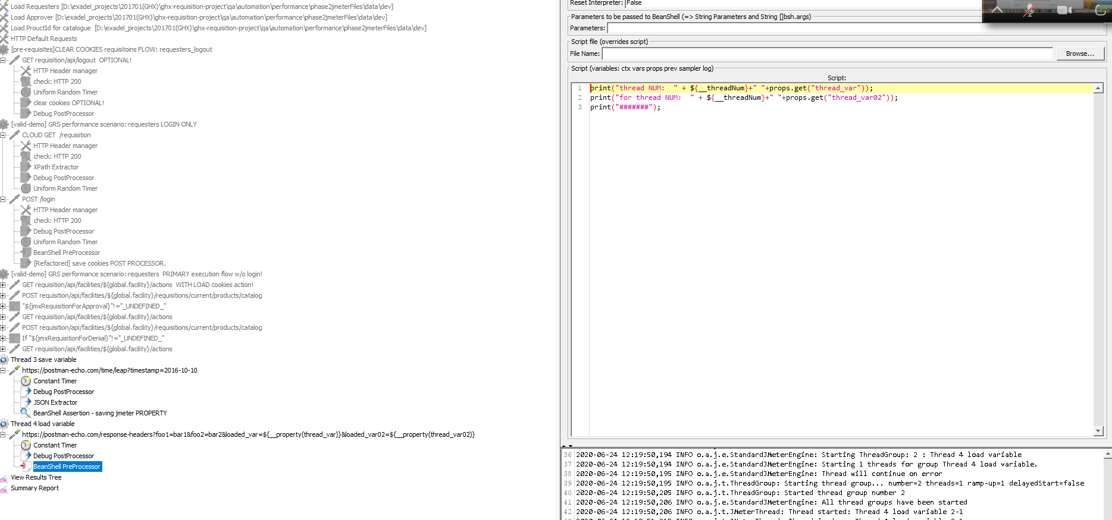
Jmeter save/load between thread1 -> thread2

Slide 37
Jmeter: alter http headers during the test
You can dynamically construct your authorization header using Beanshell PreProcessor as follows:
Add empty HTTP Header Manager as a child of your request which requires authorization
Add Beanshell PreProcessor as a child of the same request with the following code: import org.apache.jmeter.protocol.http.control.Header; sampler.getHeaderManager().add(new Header("Authorization","Bearer " + vars.get("BEARER")));
This will construct fully dynamic header using BEARER variable.
sampler is a shorthand to HTTPSamplerProxy class which gives access to parent Sampler instance
vars is the instance of JMeterVariables class which allows read/write access to all JMeter variables available within the bounds of current context (usually current Thread Group)

Slide 38
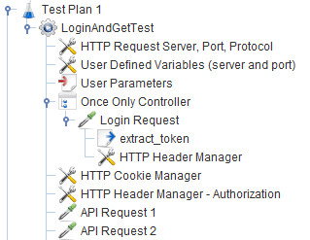
Jmeter: alter http headers during the test (alternative way)
One need to move your login under a controller. In my case, may be used an Only Once Controller. Then after the controller you can add the HTTP Header Manager with the Authorization header as "Bearer ${BEARER}" and it will read your variable. This is better because then you don't need to duplicate the BeanShell PreProcessor under every request. Tree looks like this:

Slide 39
Jmeter nogui execution #1
JMeter can be launched in non-GUI mode as follows:
jmeter -n -t /path/to/your/test.jmx -l /path/to/results/file.jtl
You can set what would you like to see in result jtl file via playing with JMeter Properties.

Slide 40
Jmeter nogui execution #2
See jmeter.properties file under /bin folder of your JMeter installation and look for those starting with
jmeter.save.saveservice.
Defaults are listed below:
#jmeter.save.saveservice.output_format=csv
#jmeter.save.saveservice.assertion_results_failure_message=false
#jmeter.save.saveservice.assertion_results=none
#jmeter.save.saveservice.data_type=true
#jmeter.save.saveservice.label=true
#jmeter.save.saveservice.response_code=true
#jmeter.save.saveservice.response_data=false
#jmeter.save.saveservice.response_data.on_error=false
#jmeter.save.saveservice.response_message=true
#jmeter.save.saveservice.successful=true
#jmeter.save.saveservice.thread_name=true
#jmeter.save.saveservice.time=true
#jmeter.save.saveservice.subresults=true
#jmeter.save.saveservice.assertions=true
#jmeter.save.saveservice.latency=true
#jmeter.save.saveservice.samplerData=false
#jmeter.save.saveservice.responseHeaders=false
#jmeter.save.saveservice.requestHeaders=false
#jmeter.save.saveservice.encoding=false
#jmeter.save.saveservice.bytes=true
#jmeter.save.saveservice.url=false
#jmeter.save.saveservice.filename=false
#jmeter.save.saveservice.hostname=false
#jmeter.save.saveservice.thread_counts=false
#jmeter.save.saveservice.sample_count=false
#jmeter.save.saveservice.idle_time=false
#jmeter.save.saveservice.timestamp_format=ms
#jmeter.save.saveservice.timestamp_format=yyyy/MM/dd HH:mm:ss.SSS
#jmeter.save.saveservice.default_delimiter=,
#jmeter.save.saveservice.default_delimiter=\t
#jmeter.save.saveservice.print_field_names=false
#jmeter.save.saveservice.xml_pi=<?xml-stylesheet type="text/xsl" href="../extras/jmeter-results-detail-report_21.xsl"?>
#jmeter.save.saveservice.base_prefix=~/
#jmeter.save.saveservice.autoflush=false
Uncomment the one you are interested in and set it's value to change the default. Another option is override property in user.properties file or provide it as a command-line argument using -J key as follows:
jmeter -Jjmeter.save.saveservice.print_field_names=true -n /path/to/your/test.jmx -l /path/to/results/file.jtl
See Apache JMeter Properties Customization Guide for more details on what can be done using JMeter Properties.

Slide 41
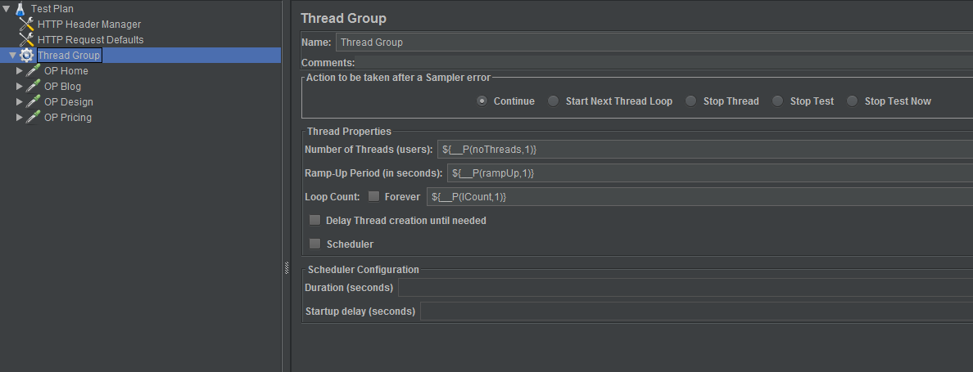
Jmeter nogui run parametrization (custom batch with command line params)
jmeter -JnoThreads=2 -JrampUp=1 -JlCount=2 -n -t OctoPerf.jmx

Slide 42
Jmeter dashboard generation command basing on existing .jtl log file
jmeter -g "jtl_path\logdebug.jtl" -o "folder_path\dashboard"
Jmeter nogui execution + dashboard generation
jmeter -n -t "full path\myJMX.jmx" -l "full path\myLogs.jtl" -e -o "full_path\dashboard" & pause

Slide 43
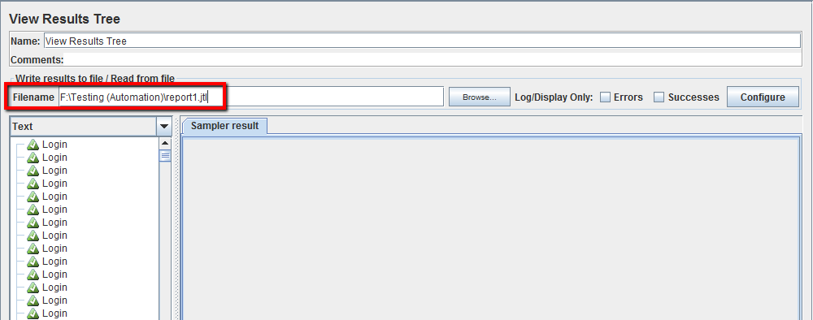
Jmeter generate dashboard HTML report right after nogui execution
In short, yes you have to run test from GUI and get dashboard report for the same.
Add a listener to your test script in GUI mode. From every test, you can generate report file (.jtl file) in default CSV format.
In your listeners, you can save your report file (.jtl file) like this. Just put the full path of your file and the run the test.
his will automatically generates the .jtl/.csv reports after test completion.
Then you can read and process samples from CSV files to generate HTML files containing graph views.
Now, Generating report from the existing .jtl results file:
jmeter -g /path/to/jtl/file -o /where/you/want/to/store/dashboard

Slide 44
Dashboard report customization
https://jmetervn.com/2017/01/04/how-to-generate-dashboard-report-in-jmeter/

Slide 45
Jmeter and Maven integration. Project example
Jmeter and Maven integration . Project example.

Slide 46
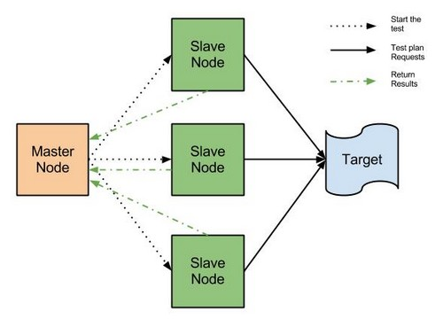
Jmeter distributed execution (server <-> nodes)
fdfd
fdfdfdfdfdfffffffffffffffffffffffff

Slide 47
Jmeter distributed execution setup (separate lesson?)
Guidelines - how to organize and setup jMeter in distributed mode (e.g for 10k+ users simulation):
https://docs.google.com/document/d/1z4ZHBJEvR1CZplv0NkWkHEOAuqX9PYZiLAjsUXyNEEI/edit?usp=sharing

Slide 48
Github repo
https://github.com/eugenepolschikov/jmeter-advanced-materials

